Slide 1

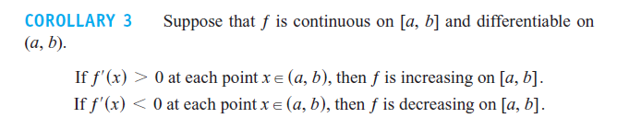
Section 4.3 Monotonic Functions and
the First Derivative Test

Slide 2
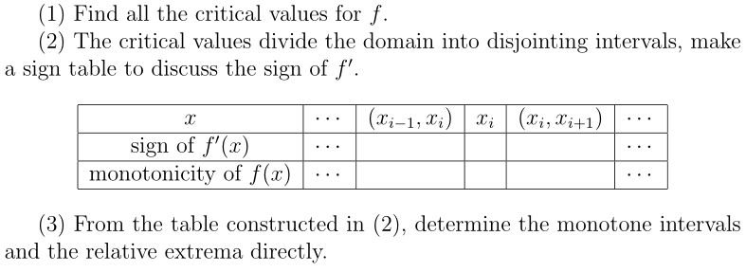

Slide 4

Example 2.

Slide 5
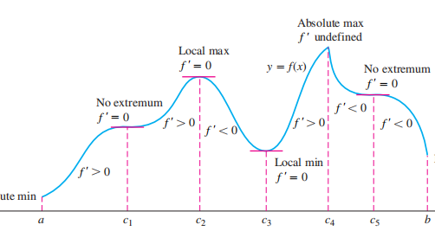
First Derivative Test for Local Extrema

Slide 6
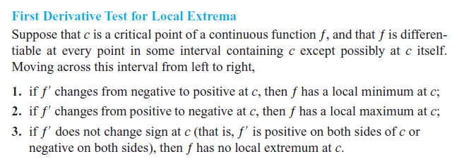
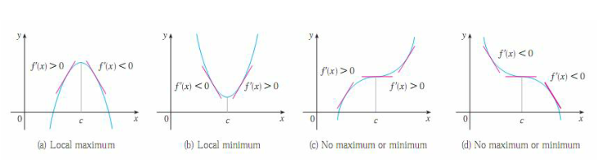

Slide 8
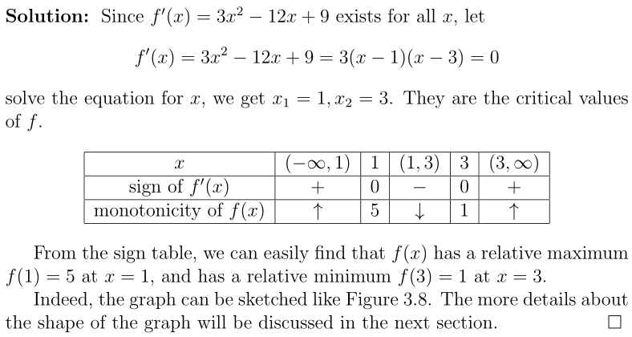
Example 3.

Slide 9

Example 4. Find the critical points of

Slide 10

Example 5. Find the critical points of

Slide 11

Exercise:
a. Identify the function’s local extreme values in the given domain, and say where they occur.
b. Which of the extreme values, if any, are absolute?

Slide 13
Homework: P242 22, 40, 80

